Slide 1
Cloud-based
Healthcare Apps
23. November, 2022
Thomas Hildebrandt, Tilman Zuckmantel
Software, Data, People & Society
Datalogisk Institut Københavns Universitet

Slide 2
80’s
SQL
Database
Standards for data
in databases (SQL),
shared within the enterprise

Slide 3
80’s
90’s
SQL
Database
Standards for data
in databases (SQL),
shared within the enterprise
User interface (UI) standards
and sharing data over
the Internet
(WWW, HTML, HTTP, URL)

Slide 4
80’s
90’s
00’s
Cloud computing,
Digital signature,
Secure email,
eInvoicing,
eIncome,
Digital Post,
NemID,
NemSMS,
Common IT infrastructure
for authorities
SQL
Database
Standards for data
in databases (SQL),
shared within the enterprise
User interface (UI) standards
and sharing data over
the Internet
(WWW, HTML, HTTP, URL)

Slide 5
80’s
90’s
00’s
20’s ?
Cloud computing,
Digital signature,
Secure email,
eInvoicing,
eIncome,
Digital Post,
NemID,
NemSMS,
Common IT infrastructure
for authorities
SQL
Database
Let’s find out !
Standards for data
in databases (SQL),
shared within the enterprise
User interface (UI) standards
and sharing data over
the Internet
(WWW, HTML, HTTP, URL)

Slide 6
Distributed Systems¹
multiple autonomous machines involved
appears as a single coherent system
¹Steen, Tannenbaum
Notes:
Kleines Beispiel geben mit einer Applikation, die drei Komponenten hat, Ärzte, Patienten und Behandlungen und dann eben eine Fiktive app im User Interface, die um eine bestimmte Operation auszuführen

Slide 7
Distributed Systems
Key characteristics
Distinct Processes interacting via (asynchronous) message passing
Ressource sharing
Concurrency
Open systems (standard prototcols)
No centralized clock
Scalability
Change
Key issues
Failures
Transparency
Security
Notes:
- asynchronous message passing (use the illustration from above to illustrate how a component can keep on working, instead of blocking(synchronous))
- Resource Sharing: makes it easier to access and share resources, for example data, files (Bit Torrent)
- Concurrency, give an example of concurrent math operation (2+2)+(4+4), spread across two machines
- no centralized clock: machines are running on different clocks and thus no synchronized clock.
- scalability, how can you scale your system ? Add more nodes (horizontal scaling), add more computing power. Also if nodes are laying much further away, we want the user not to be aware of this (geographical scaling)
change: many parts of the system might be replaced, message topologies might be changed, the whole system when it evolves need to be adaptable for these changes
- because a node of a system can fail the system needs to be able to deal with that. Often hard to forsee all possible errors that can occur in the interplay of nodes
- Distribution transparacy is how much you want to hide the nature of your distributed system. For example it is sometimes useful to give detailed information. Such as latency in calls around the globe
- Security is of course an issue when so many nodes are evolved, how to propagate from node to node hat an authorized user is trying to access a service ?

Slide 8



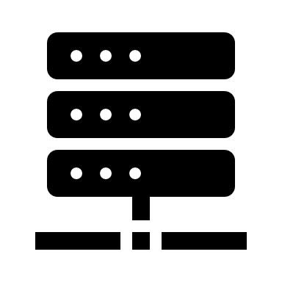
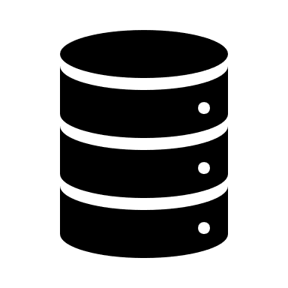
Distributed Systems Architectures
Client-server
Tier-2
Internet
request
response
Client
Server

Slide 9
Distributed Systems Architectures
Client-server
Tier-3
Internet
Internet
request
response
Client
Application Server
Database Server

Slide 10
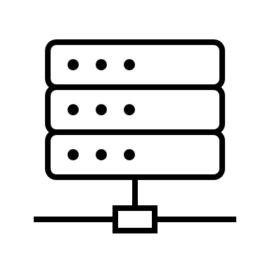
Distributed Systems Architectures
Client-server
Tier-4
Internet
Internet
request
response
Client
Application Server
Cache Server
Database Server

Slide 11
Distributed Systems Architectures
Client-server
Tier-4
Internet
Internet
Client 1
request
response
Client 2
Application Server
Cache Server
Database Server
Client 3

Slide 12
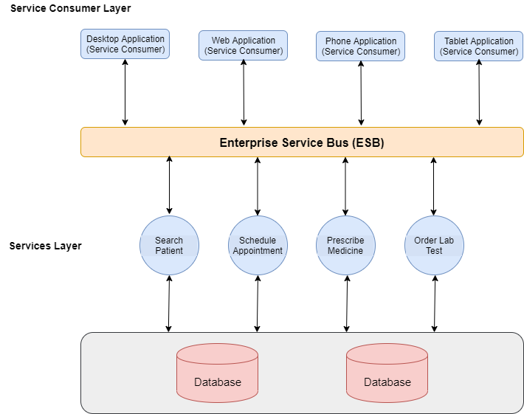
Distributed Systems Architectures
Service Oriented Architecture (SOA)
Application Logic divided into small functions with an isolized purpose
Figure: https://medium.com/@adeelsarwarblog/what-is-service-oriented-architecture-9b4406fcedeb

Slide 13
Distributed Systems
Software-as-a-Service (SaaS)
Cloud provider hosts applications and makes them available for end-users (Google Workspace, Microsoft 365, etc.)
Platform-as-a-Service (PaaS)
Licensing a platform for services, e.g. amazon web services or google app engine

Slide 14
Historic Web-service standards

Slide 15
REST (Representational State Transfer) Services (Roy Fielding, 2000)
Uniform Interface
Identification of resources
Manipulation of resources through representations
Self-descriptive messages
Client server
Stateless (i.e. no session state)
Cacheable
Often uses HTTP protocol to access and manipulate services (POST, DELETE, GET, PUT)
JSON or XML often used to represent data

Slide 16
REST live example

Slide 17

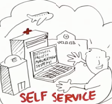
Proces-Aware Information System (PAIS)
& Service-Oriented Architecture (SOA)
Signavio.com or DCRSolutions.net
BPMS
Services.
Business Activity Monitor (BAM)

Slide 18
Process Models, Process Instances, User Worklists

Slide 19
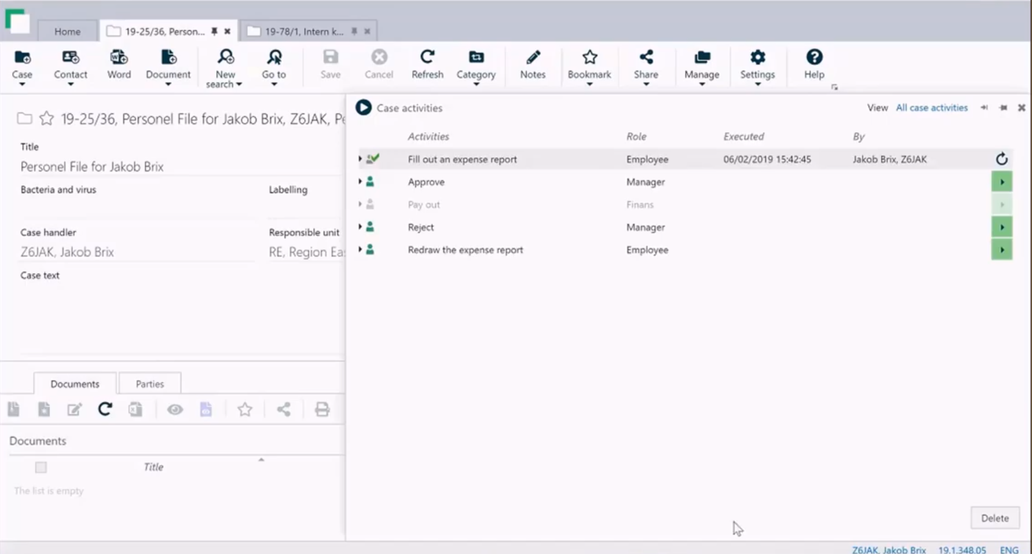
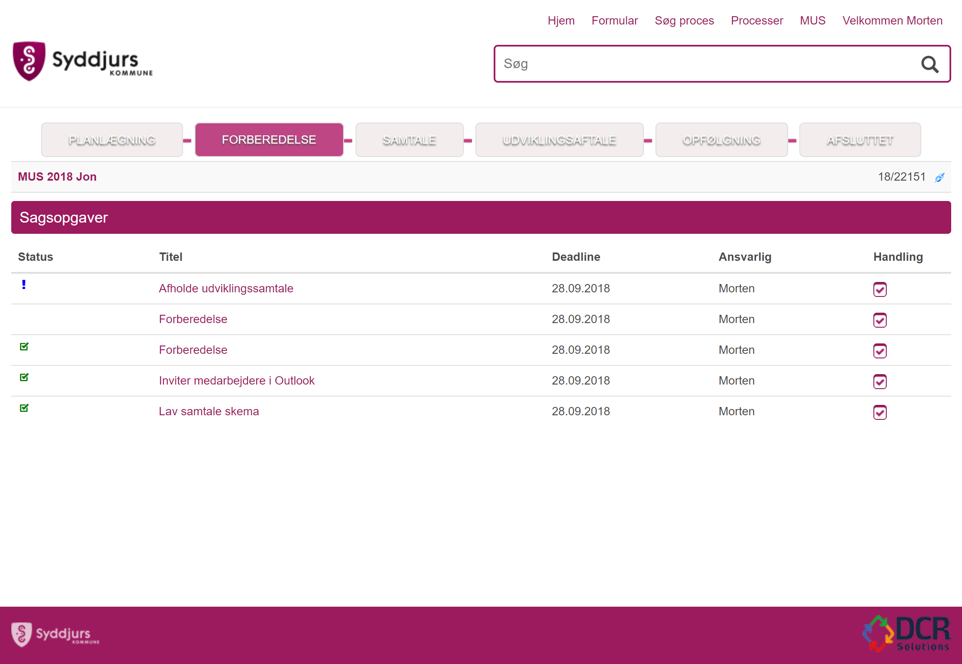
Examples of work lists in workflow tools
DCR Open Case Manager

Slide 21
Different degrees of flexibility
Workflow management
Business Process Management
& code
Adaptive Case Management
”Groupware” (E.g. Teams)

Slide 22
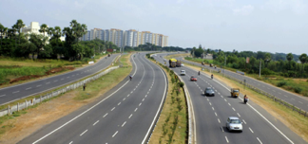

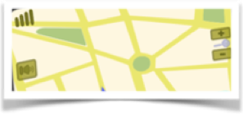
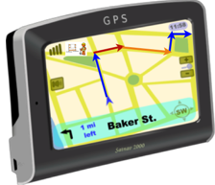
From automating the welknown and stable to supporting knowledge workers navigate changing rules and regulations
Structured:
Digitalisation & Business Process Management as code, BPM & RPA
Semi Structured:
Supported by Electronic Document and Adaptive Case Management (ESDH & ACM)
Unstructured
BI, AI & Process Mining
Welknown and stable
Complex and changing
Unknown
Need for understandable
and up-to-date map of rules and travel planner
Notes:
Hvor er KU henne ift. disse?

Slide 23
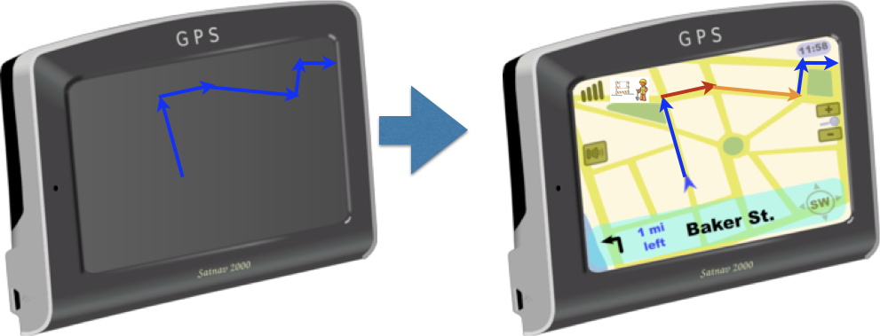
Key Enabling Technology: Dynamic Condition Response Graphs
10 years of R&D between academia & industry
Declarative, rule based models
Captures why not just how
Allow all compliant paths
Can be modelled incrementally
Maintainable, e.g. when regulations or business change
Supports validation via simulation and formal analysis

Slide 24
Thomas will continue next week with DCR, ... we are going to look into UI, ...but first...

